Slide 1
CNCF
Cloud Native Computing Foundation

Slide 2

The Cloud Native Computing Foundation was founded in 2015 to promote containers.
It was announced with Kubernetes 1.0, an open source container cluster manager, which was contributed to the foundation by Google
Founding members included Google, CoreOS, Mesosphere, Red Hat, Twitter, Huawei, Intel, Cisco, IBM, Docker, Univa, and VMware.

Slide 3
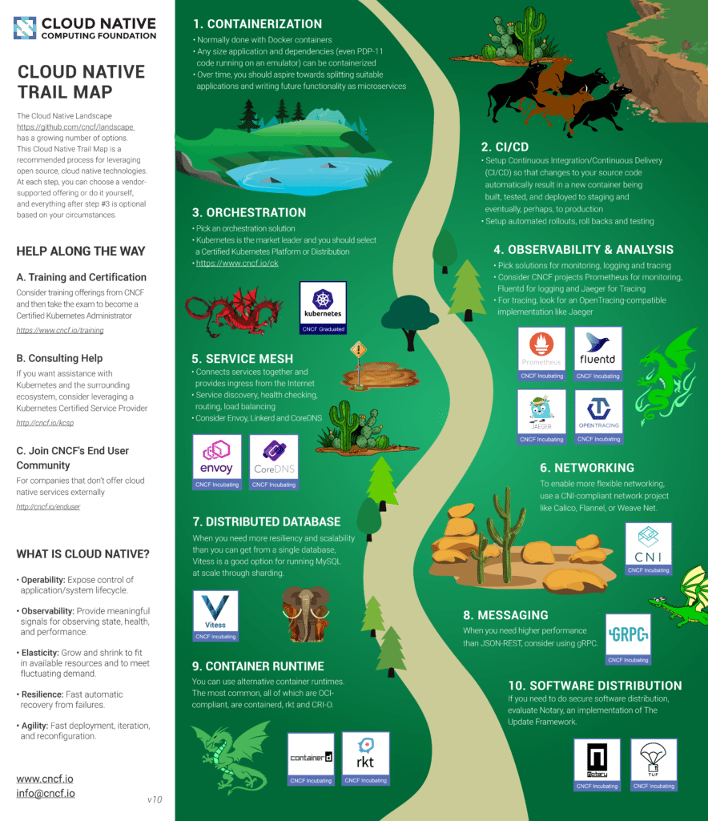
CNCF TrailMap
1- Containerization
2-CICD
3-Orchestration
4-Observability&analysis
5-server mesh
6-networking
7-distributed database
8-messaging
9-container runtime
10-software distributioin

Slide 4
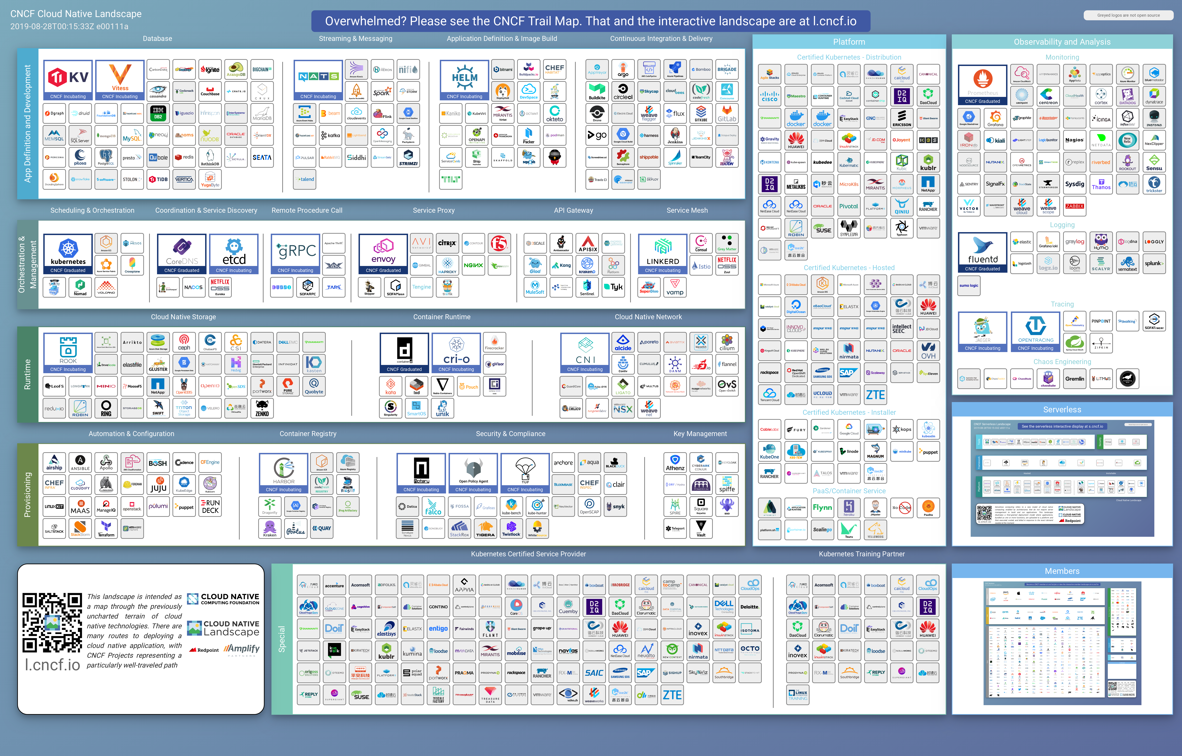

Slide 5
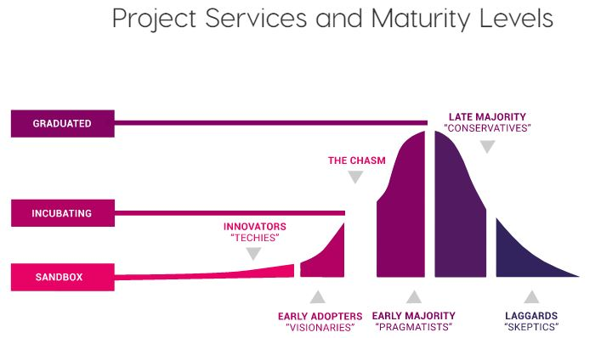
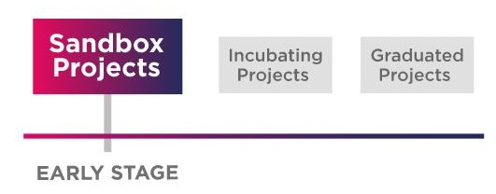

Slide 6
app definition and development :
-Data Base
-streaming & messaging
-application deffinition & image build
-CICD (Jenkins , gitlab)

Slide 7
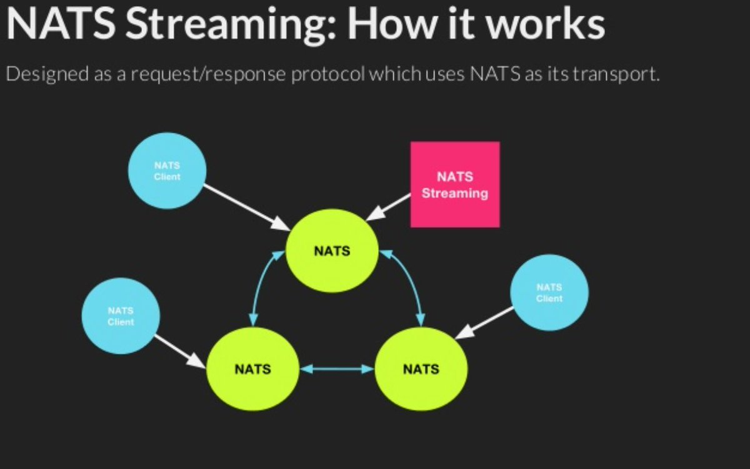

Masseging systems or Message-oriented middleware (MOM)
app definition and development
(MOM) is software or hardware infrastructure supporting sending and receiving messages between distributed systems.
APIs that extend across diverse platforms and networks are typically provided by MOM.

Slide 8
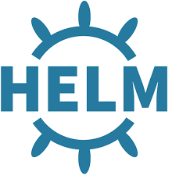
application deffinition & image build
app definition and development
In order to reduce error and organize complexity when deploying an application, CI/CD systems must include robust tooling for package management/deployment and pipelines with automated testing.
Two Kubernetes-specific tools developed to solve this problem are the Helm package manager and the Jenkins X pipeline automation tool.

Slide 9
orchestration & management:
-scheduling & orchestration (K8s)
-coordination & service discovery
-remote procedure call
-service proxy
-api gateway
-service mesh

Slide 10
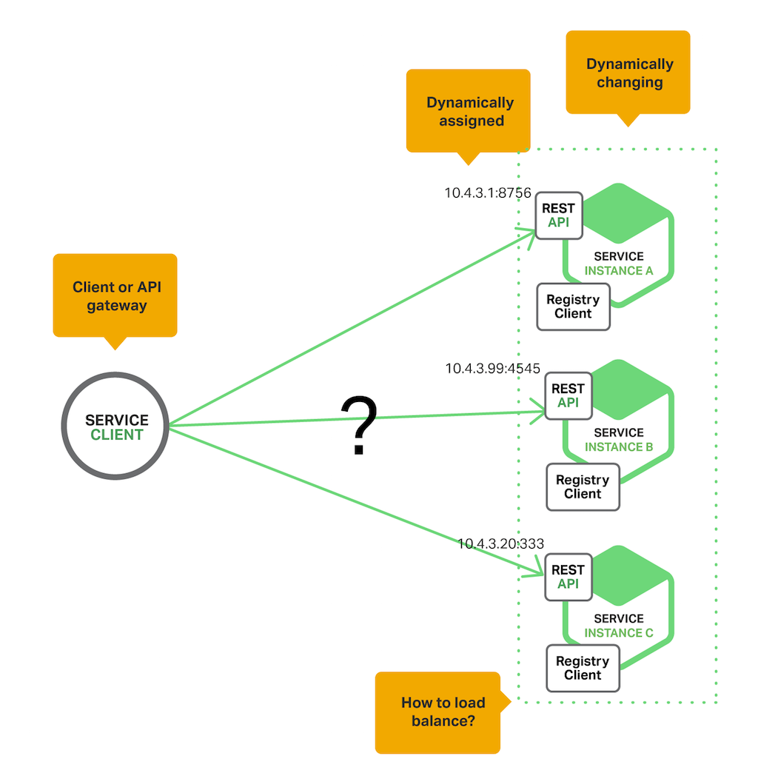
coordination & service discovery:
orchestration & management
Why Use Service Discovery?
imagine that you are writing some code that invokes a service that has a REST API. In order to make a request, your code needs to know the network location (IP address and port) of a service instance. In a traditional application running on physical hardware, the network locations of service instances are relatively static. your code can read the network locations from a configuration file that is occasionally updated.
In a modern, cloud‑based microservices application, however, this is a much more difficult problem to solve as shown in the following diagram.

Slide 11
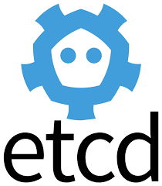
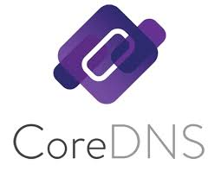
In a microservices application, the set of running service instances changes dynamically. Instances have dynamically assigned network locations. Consequently, in order for a client to make a request to a service it must use a service‑discovery mechanism.
A key part of service discovery is the service registry. The service registry is a database of available service instances
There are two main service‑discovery patterns: client-side discovery and service-side discovery
coordination & service discovery

Slide 12
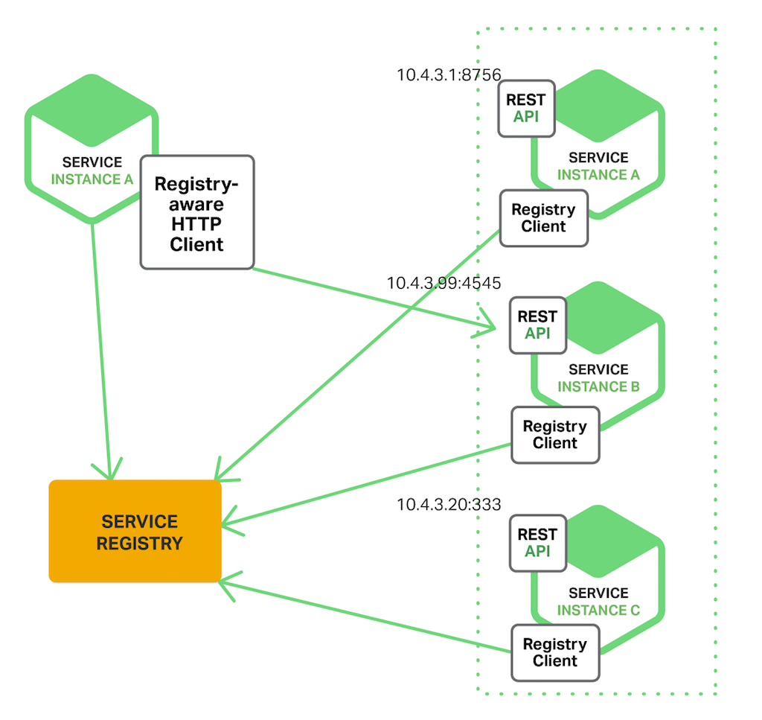
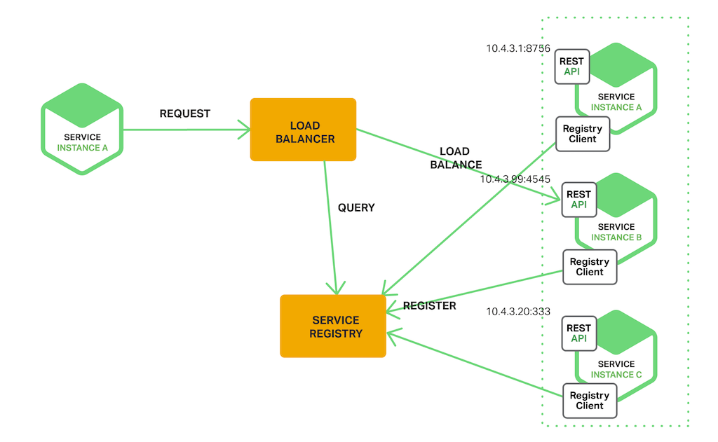
Client-side and server-side Discovery Pattern:
coordination & service discovery

Slide 13
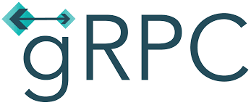
remote procedure call:
orchestration & management
Remote Procedure Call (RPC) is a protocol that one program can use to request a service from a program located in another computer on a network without having to understand the network's details. A procedure call is also sometimes known as a function call or a subroutine call.

Slide 14
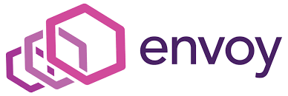
Service proxy:
orchestration & management
FEATURES:
OUT OF PROCESS ARCHITECTURE
HTTP/2 AND GRPC SUPPORT
ADVANCED LOAD BALANCING
APIS FOR CONFIGURATION MANAGEMENT
OBSERVABILITY

Slide 15
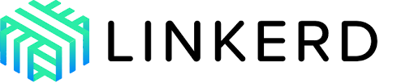
service mesh:
orchestration & management
A service mesh is a dedicated infrastructure layer that controls service-to-service communication over a network. It provides a method in which separate parts of an application can communicate with each other.
Common features provided by a service mesh include service discovery, load balancing, encryption and failure recovery. High availability is also common through utilizing software controlled by APIs rather than utilizing hardware. Service meshes can make service-to-service communication fast, reliable and secure.
An organization may choose to utilize an API gateway, which handles protocol transactions, over a service mesh.
A service mesh architecture uses a proxy instance

Slide 16
api gateway:
orchestration & management
An API gateway is programming that sits in front of an application programming interface (API) and acts as a single point of entry for a defined group of microservices. Because a gateway handles protocol translations, this type of front-end programming is especially useful when clients built with microservices make use of multiple, disparate APIs.
A major benefit of using API gateways is that they allow developers to encapsulate the internal structure of an application in multiple ways, depending upon use case. This is because, in addition to accommodating direct requests, gateways can be used to invoke multiple back-end services and aggregate the results.

Slide 17
popular API gateway features:
authentication
security policy enforcement
load balancing
cache management
dependency resolution
contract and service level agreement (SLA) management

Slide 18
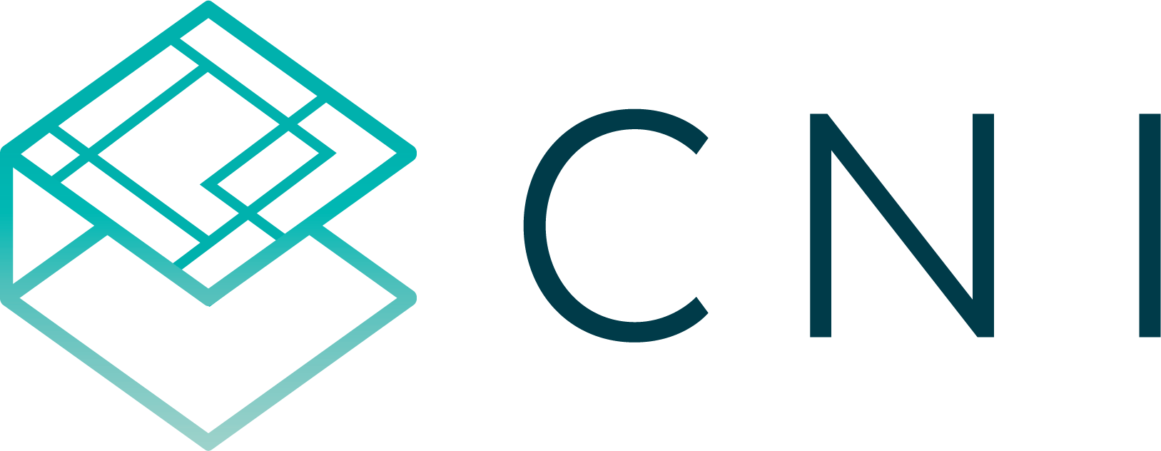
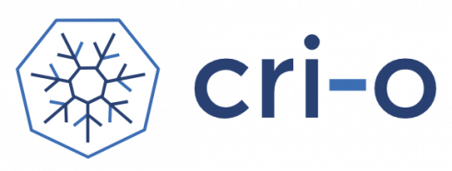
runtime :
-cloud native storage
-container runtime (Container Runtime Interface)
It is a lightweight alternative to using Docker, Moby or rkt as the runtime for Kubernetes.
-cloud native network (Container Networking Interface)

Slide 19

cloud native storage:
To turns distributed storage systems into self-managing, self-scaling, self-healing storage services.
It automates the tasks of a storage administrator: deployment, bootstrapping, configuration, provisioning, scaling, upgrading, migration, disaster recovery, monitoring, and resource management.

Slide 20



provisioning :
-automation & configuration
-container registry
-security & compliance
-key management

Slide 21
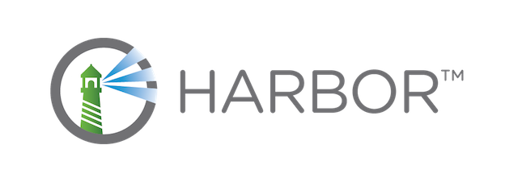
container registry:
provisioning :
cloud native registry stores, signs, and scans container images for vulnerabilities.
it solves common challenges by delivering trust, compliance, performance, and interoperability. It fills a gap for organizations and applications that cannot use a public or cloud-based registry, or want a consistent experience across clouds.

Slide 22
platform:
-certified kubernetes - distribution
-certified kubernetes - hosted
-certified kubernetes - installer
-PaaS/container service

Slide 23
observability & analysis:
-monitoring
-logging
-tracing
-chaos engeniring

Slide 24
Serverless:
The serverless intractive display at cncf

